Slide 1
Introduction to Statistics for Ecology and Evolutionary Biology The Wide World of Statistical Models Week 15 06 May 2019

Slide 2
Over-Dispersed Outcomes
Over-dispersion occurs when the observed variance in counts exceeds that expected by the model
Recall that with the Poisson distribution, for instance, the mean and variance are equal, being governed by the same parameter, lambda (𝜆)
For count data, negative-binomial (aka gamma-Poisson) models assume that each observation has its own rate
Effectively decouples the mean of the observed counts from their variance
For binomial data, beta-binomial models generate a distribution of probability of success values, better capturing heterogeneity across cases in the data
Notes:
Ignoring over-dispersion can have the same effects as ignoring any predictor variable: can confound inference or produce spurious effects

Slide 3
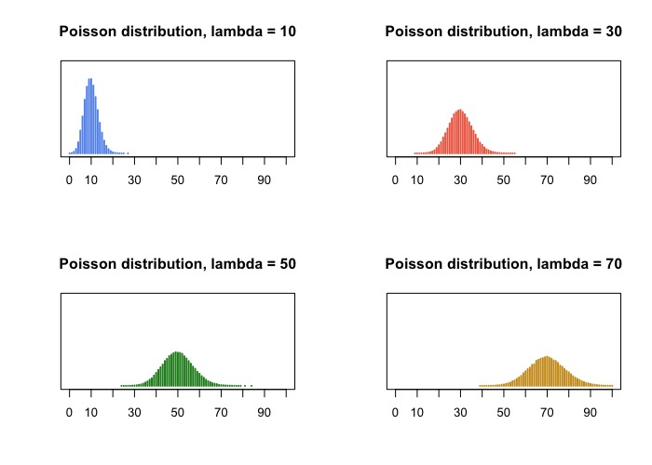
Over-Dispersed Outcomes
Notes:
With the Poisson distribution, the amount of variance is inherently tied to the mean value of the distribution

Slide 4
Over-Dispersed Outcomes
Over-dispersion occurs when the observed variance in counts exceeds that expected by the model
Recall that with the Poisson distribution, for instance, the mean and variance are equal, being governed by the same parameter, lambda (𝜆)
For count data, negative-binomial (aka gamma-Poisson) models assume that each observation has its own rate
Effectively decouples the mean of the observed counts from their variance
For binomial data, beta-binomial models generate a distribution of probability of success values, better capturing heterogeneity across cases in the data

Slide 5
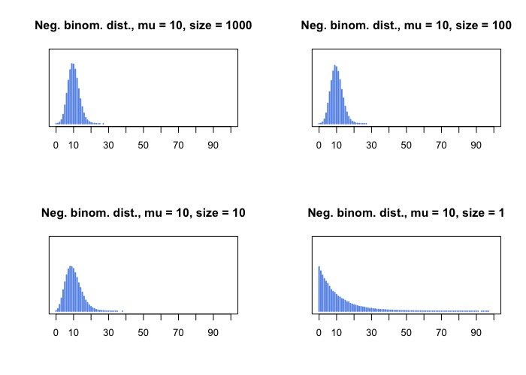
Over-Dispersed Outcomes
Notes:
Note that there are many different parameterizations (i.e., descriptions) of the same model, so it can make interpreting results difficult
Have to pay attention to the parameterization a given analysis uses, since that alters your interpretation

Slide 6
Over-Dispersed Outcomes
Over-dispersion occurs when the observed variance in counts exceeds that expected by the model
Recall that with the Poisson distribution, for instance, the mean and variance are equal, being governed by the same parameter, lambda (𝜆)
For count data, negative-binomial (aka gamma-Poisson) models assume that each observation has its own rate
Effectively decouples the mean of the observed counts from their variance
For binomial data, beta-binomial models generate a distribution of probability of success values, better capturing heterogeneity across cases in the data

Slide 7
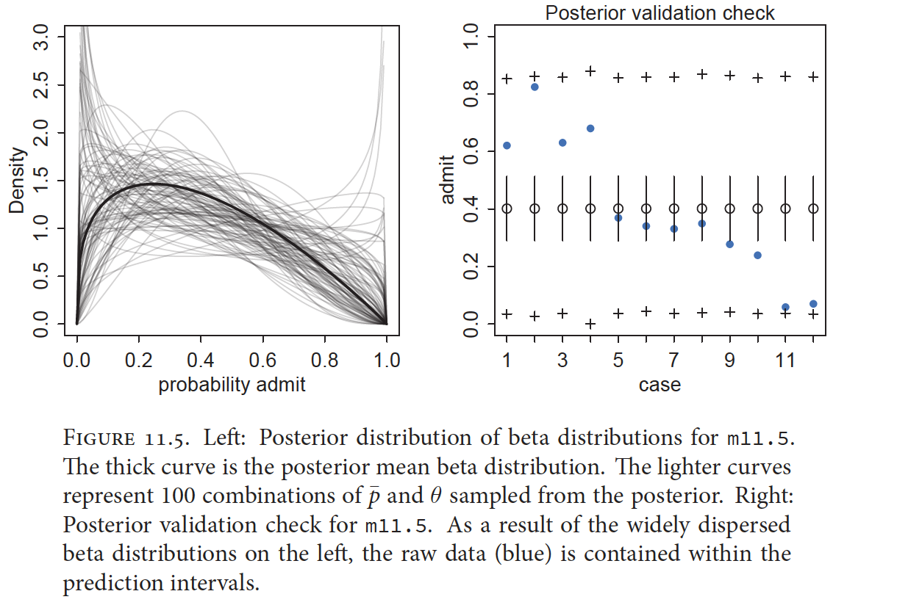
Over-Dispersed Outcomes
McElreath 2016, Statistical Rethinking

Slide 8
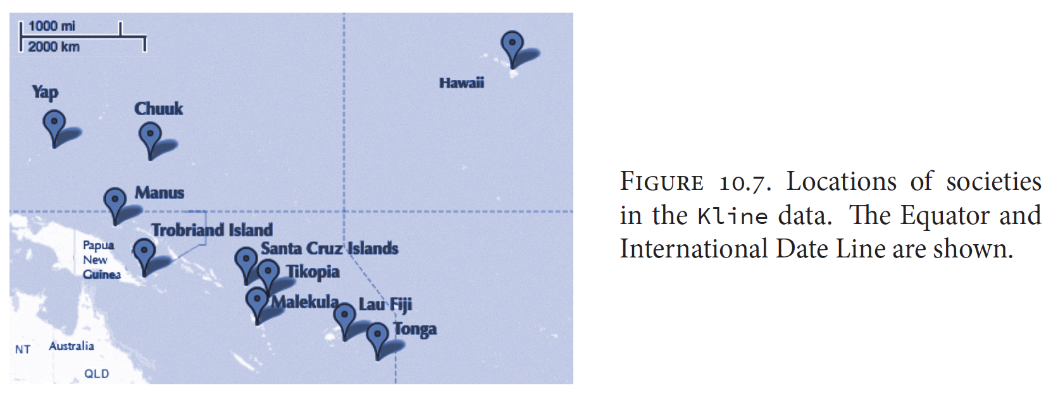
Poisson Regression for Total Tools
McElreath 2016, Statistical Rethinking
Notes:
Previously, we were interested in modeling the total number of tools developed by these 10 Oceanic societies
We used a crude categorical variable representing contact rate, in addition to population size, to predict the toolkit of a given society
This ignores the spatial configuration of the islands and the fact that sharing is more likely to happen with certain societies (which may have differing toolkits) than others

Slide 9
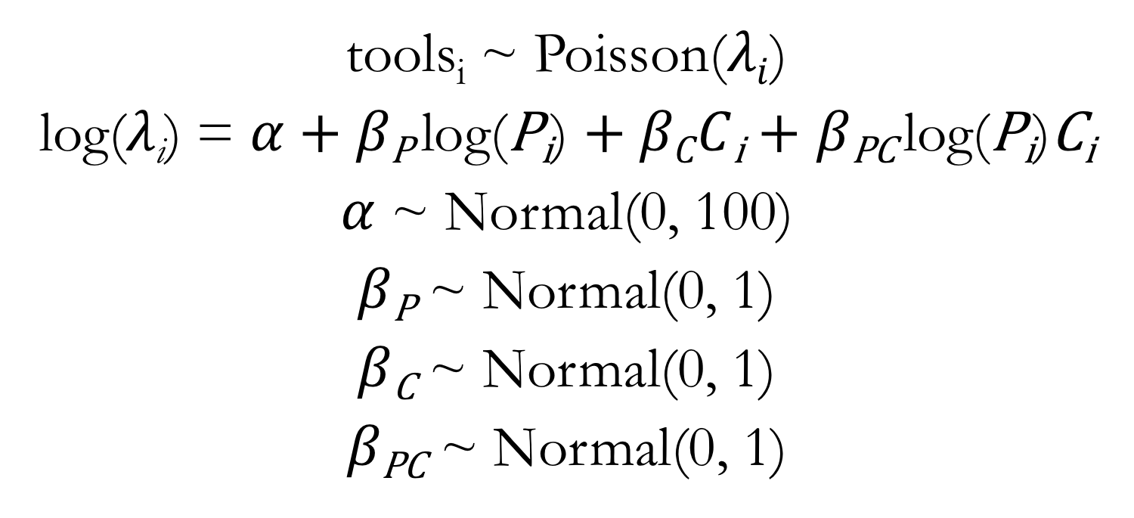
Poisson Regression for Total Tools Predictors: Population Size, Contact Rate, and Interaction
tools_{i} ~ Poisson($λi$)
log($λ\text{i}$) = $α$ + $β\text{P} \text{log}\text{(}\text{P}\text{i}$) + $βCC\text{i}$ + $β\text{PC} \text{log}\text{(}\text{P}\text{i}\text{)}\text{C}\text{i}$
$α$ ~ Normal(0, 100)
$β\text{P}$ ~ Normal(0, 1)
$β\text{C}$ ~ Normal(0, 1)
$β\text{PC}$ ~ Normal(0, 1)

Slide 10
Gaussian Process Regression
Not a very useful name for a very useful model
Key point: allows for estimation across a continuous “distance” dimension
Can be used to extend the varying effects approach to continuous categories
Notes:
Note that the dimension of distance can literally be distance (as it is in this case), but could also be an abstract “distance” metric
https://katbailey.github.io/post/gaussian-processes-for-dummies/

Slide 11
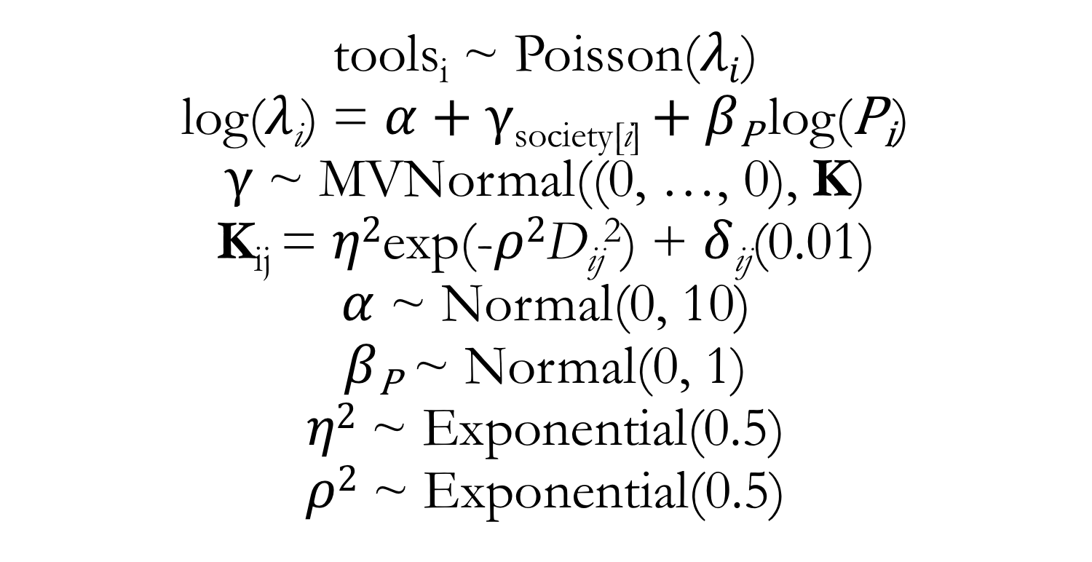
Gaussian Process Regression for Total Tools Predictors: Population Size and Distance Between Societies
tools_{i} ~ Poisson($λi$)
log($λ\text{i}$) = $α$ + $γ$_{society[i]} $+ β\text{P} \text{log}\text{(}\text{P}\text{i}$)
$γ$ ~ MVNormal((0, …, 0), K)
K_{ij} = $η2$exp(-$ρ2$D_{ij}²) + $δ$_{ij}(0.01)
$α$ ~ Normal(0, 10)
$β\text{P}$ ~ Normal(0, 1)
$η2$ ~ Exponential(0.5)
$ρ2$ ~ Exponential(0.5)
Notes:
K defines a covariance matrix that is used to derive the society-specific intercept values
Show lecture code on fitting a Gaussian process regression

Slide 12
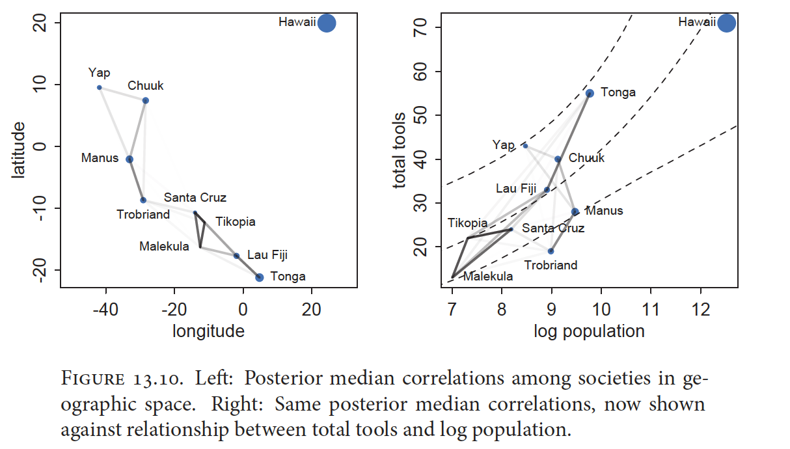
Gaussian Process Regression for Total Tools
McElreath 2016, Statistical Rethinking
Notes:
Note other “distances” to be used in these types of models: age, phylogenetic distance, network relation, etc.

Slide 13
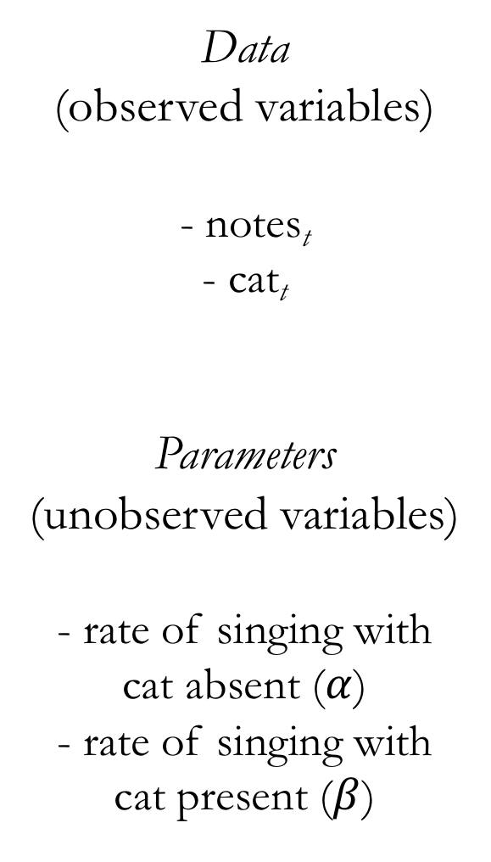
Data
(observed variables)
- notes_{t}
- cat_{t}
Parameters
(unobserved variables)
- rate of singing with
cat absent ($α$)
- rate of singing with
cat present ($β$)

Slide 14
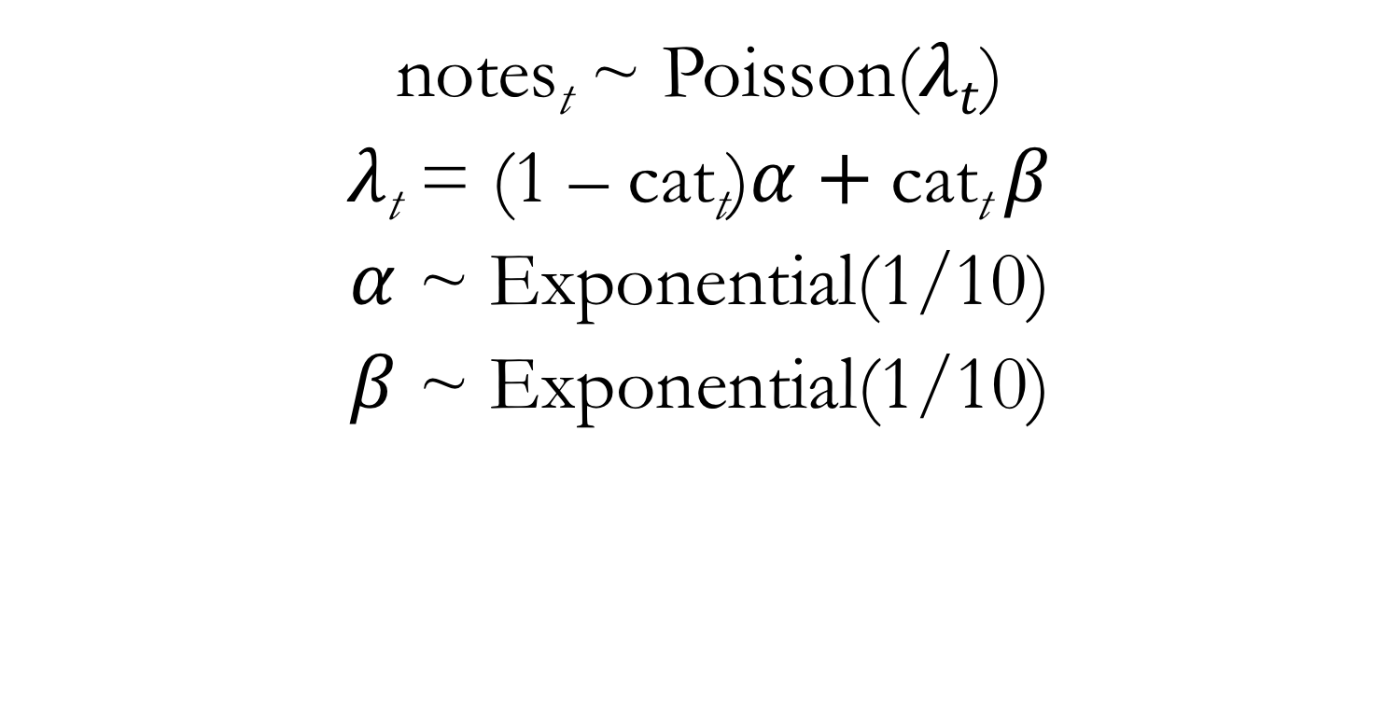
Birdsong Poisson Regression
notes_{t} ~ Poisson($λt$)
$λ\text{t}$ = (1 – cat_{t})$α$ +$\text{cat}\text{t} β$
$α$ ~ Exponential(1/10)
$β$ ~ Exponential(1/10)
Notes:
The distribution assigned to data we typically call a likelihood
The distribution assigned to parameters we typically call a prior

Slide 15
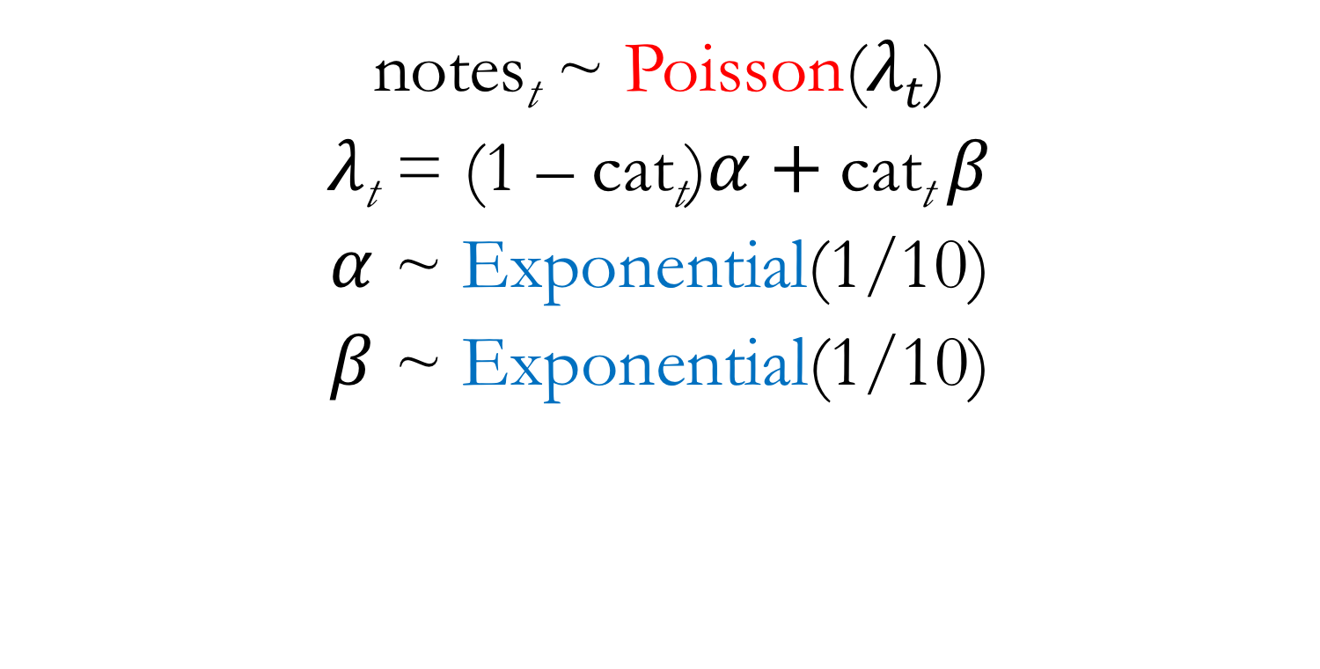
Birdsong Poisson Regression
notes_{t} ~ Poisson($λt$)
$λ\text{t}$ = (1 – cat_{t})$α$ +$\text{cat}\text{t} β$
$α$ ~ Exponential(1/10)
$β$ ~ Exponential(1/10)
Likelihood - Prior
Notes:
The distribution assigned to data we typically call a likelihood
The distribution assigned to parameters we typically call a prior
Show lecture code fitting this Poisson regression

Slide 16
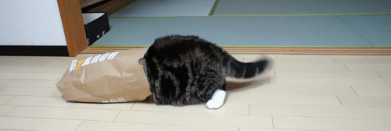
But what if some of our data about cat presence/absence were to go missing?

Slide 17
Data
(observed variables)
- notes_{t}
- cat_{t}
?
In some cases, our “data” are actually unobserved

Slide 18
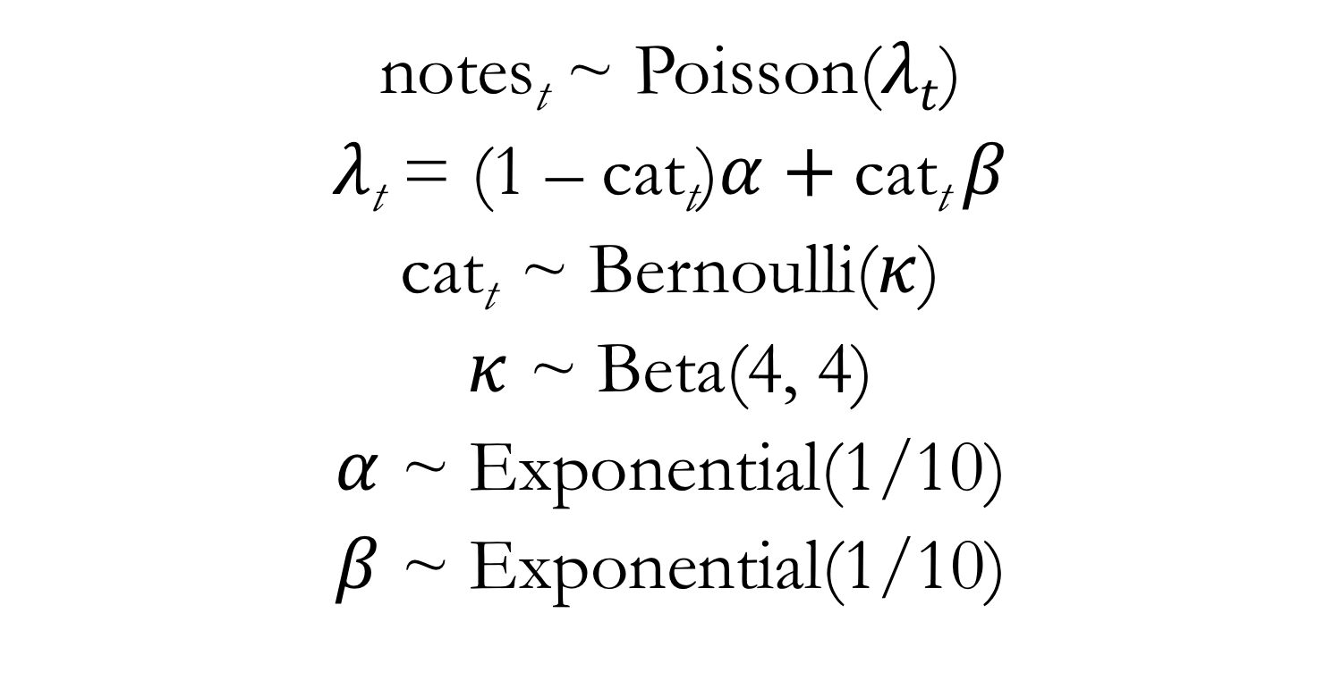
Birdsong Poisson Regression with Missingness
notes_{t} ~ Poisson($λt$)
$λ\text{t}$ = (1 – cat_{t})$α$ +$\text{cat}\text{t} β$
cat_{t} ~ Bernoulli($κ$)
$κ$ ~ Beta(4, 4)
$α$ ~ Exponential(1/10)
$β$ ~ Exponential(1/10)
Notes:
Now we explicitly model the proportion of the time the cat is there

Slide 19
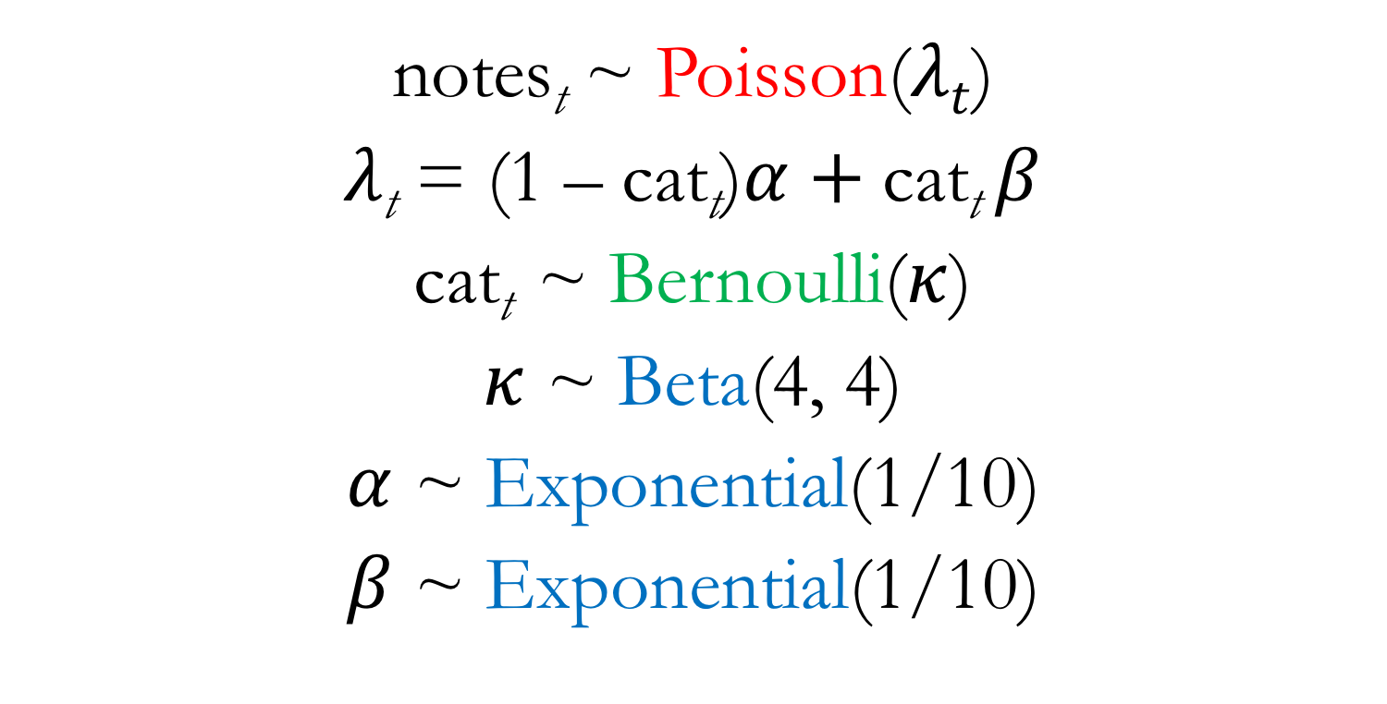
Birdsong Poisson Regression with Missingness
notes_{t} ~ Poisson($λt$)
$λ\text{t}$ = (1 – cat_{t})$α$ +$\text{cat}\text{t} β$
cat_{t} ~ Bernoulli($κ$)
$κ$ ~ Beta(4, 4)
$α$ ~ Exponential(1/10)
$β$ ~ Exponential(1/10)
Likelihood – Prior – Both
Notes:
So “cat” is both data and parameter, depending upon whether it is missing
And the Bernoulli distribution is both likelihood and prior, depending upon whether “cat” is missing
In a Bayesian model, information is flowing in all directions:
We’re asking whether or not cat presence impacts the rate of bird singing
But equally we can ask how the rate of bird singing might inform us whether or not the cat is there (when cat data is missing)
Show lecture code fitting this Poisson regression

Slide 20
Course Takeaways
Simplicity and power of Bayesian updating
Embrace and communicate uncertainty
Convey model results through visualization and implied prediction, not (just) tables of estimates
Be wary of overfitting
Models motivated by science, not statistics
A general framework with many specific implementations
Notes:
Bayesian models update prior information based on data to which we expose them
A simple framework for thinking about the process of statistical inference
Highly informative data result in more informative posteriors; data with limited sample size or weak trends will be reflected in posterior uncertainty
Acknowledging the uncertainty in our models, as represented by the posterior distribution, is central to Bayesian inference
Focuses us on the full posterior distribution rather than point estimates
Predictions on the scale of our outcome data are almost always easier to interpret than tables of parameter estimates
No matter the savviness/complexity of our modeling approaches, our models cannot do the really hard work of getting us to ask them precise, insightful scientific questions
My hope is that rather than statistical recipes, you’ve gathered some familiarity with statistical “cooking” that can serve you well as you implement these methods and move on to others

Slide 21
Thank You!

